Slide 1
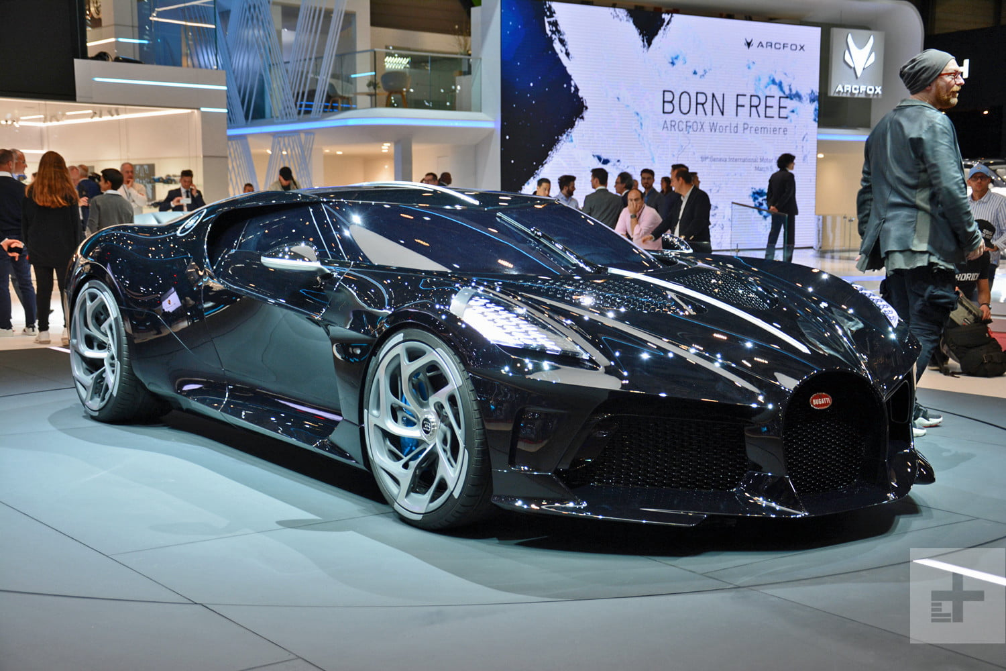
SELF DRIVING CAR BY APPLYING DEEP LEARNING TECHNIQUE
Under guidance of: Submitted by:
Prof. S bharathiraja Chirag Sharma
(18MCA1009)

Slide 2
TOC
Overview
Behavioral Cloning
Conclusion
Requirements: (Software)
Network Architecture
Reference
Problems to solve
Result

Slide 3
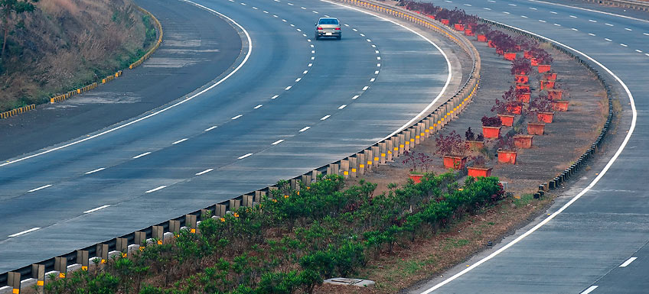
Overview
My mission is to go in detail of how to control autonomous car.
This technology was built initially using the robotics approach. Yet, with the headway in the field of computer vision and AI, we can use the deep learning approach.
Develop a model of a car motion.
Test our control design in our stimulator.

Slide 4
Requirements: (Software)
Here we have used python platform for our model because through python we can easily approach to a Deep learning algorithm
In python we are using some libraries like Matplotlib, OpenCV, NumPy etc.
Above libraries are using for calculation like Statistical approach for Arithmetic approach and for reading or analyze image etc.

Slide 5
Problems to solve
The main problem that companies are facing in this project is cost.
As nearly all car crashes are caused by driver error, driverless vehicles would viably dispose of about all dangers related to driving .
1
3
Error rate of the self driving vehicle is more .
2
.

Slide 6
BEHAVIORAL CLONING

Slide 7
Behavioral cloning is a technique by which sub-psychological aptitudes like - perceiving objects, understanding while simultaneously performing an action can be captured and imitated in a computer program.

Slide 8
Network Architecture

Slide 9
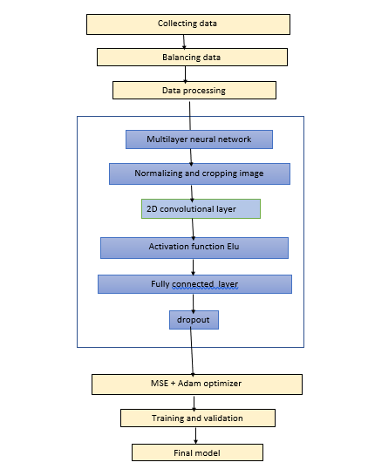
Block diagram
The algorithm developed to consist of modules that start from collecting data which consist of images, steering angles, and speed. Then came the balancing part followed by processing which is very important for the proper preparation of data entering the neural network

Slide 10
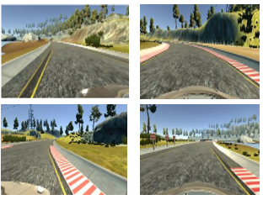
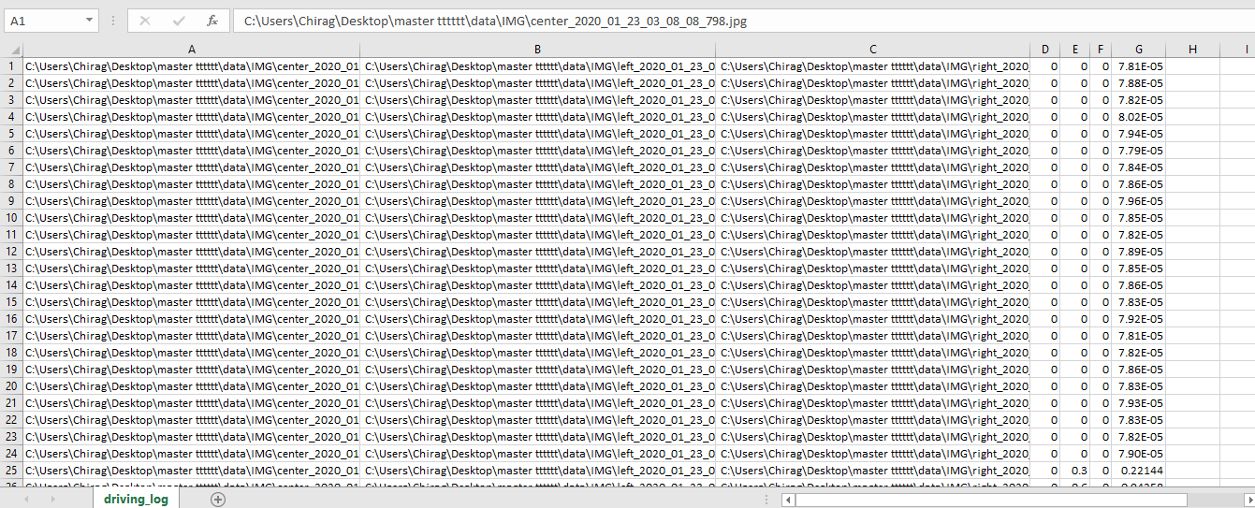
Collecting data
01
Download the open source stimulator.
Drive it by our own and record it to collect the data.
Create GitHub repository.

Slide 11
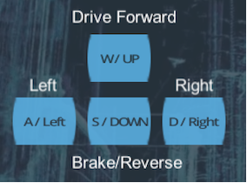
Controls for Data collection

Slide 12
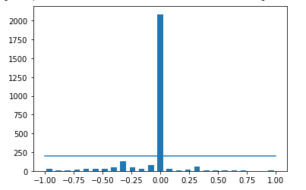
Balancing data 02
Graph the steering angles.
Visualize the graph
Set a threshold

Slide 13
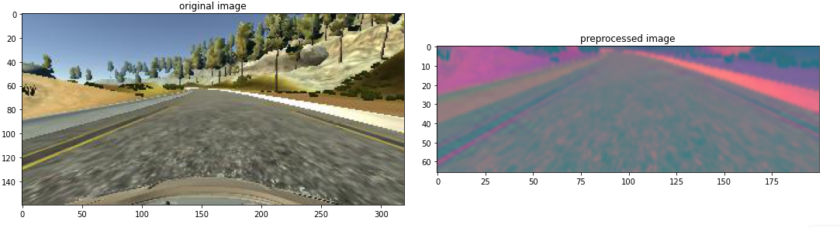
Preprocessing Data 03
we wipe out all the non relevant portion from the image.
Change the color space of the image.
Add gaussian blur technique for smoothing and reducing the noise within the image.

Slide 14
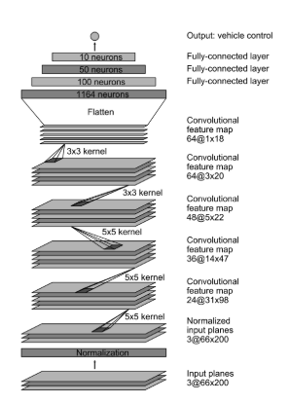
Model
Normalization layer (hard-coded)- divide by 127.5 and subtract 1.
3 convolution layers with 24, 36, 48 filters, 5*5 kernel and stride of 2.
2 convolution layers with 64 filters M, 3 *3 kernel and stride 1.
A flatten layer

Slide 15
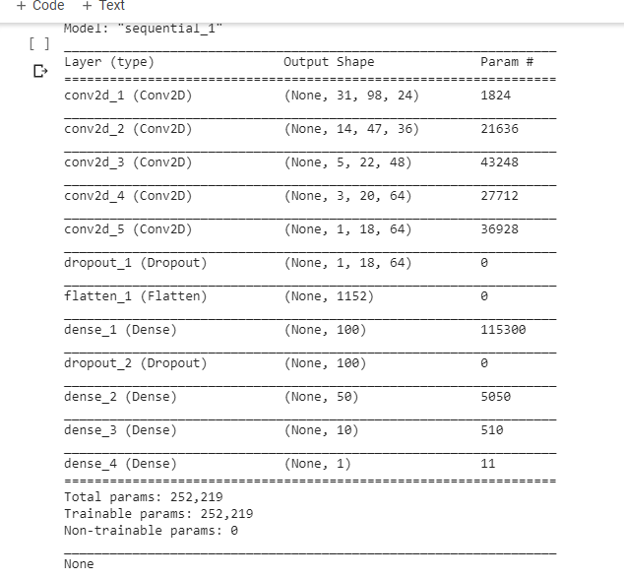
Model
A flatten layer
3 fully connected layers with output sizes of 100, 50, 10
and final output layer which outputs the steering angle.

Slide 16
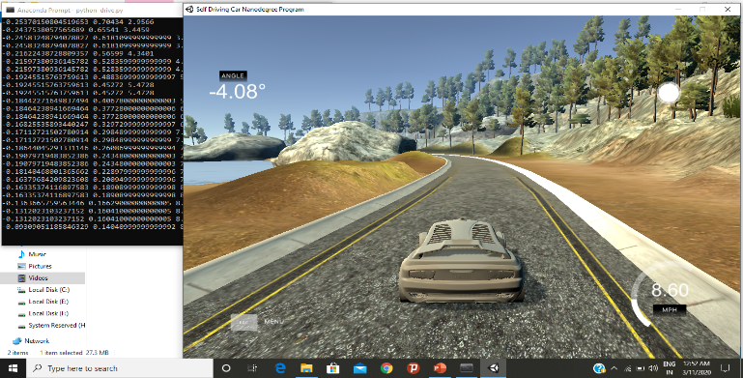
RESULT
After applying the above method here are the results, the car is running on its track and the result is also very promising. Here you can see in the rightmost corner there is the speed meter. The trained model can successfully control the car.
With a bigger training dataset comprising of various scenarios, the models’ capacity to remain in autonomous mode will increase.

Slide 17
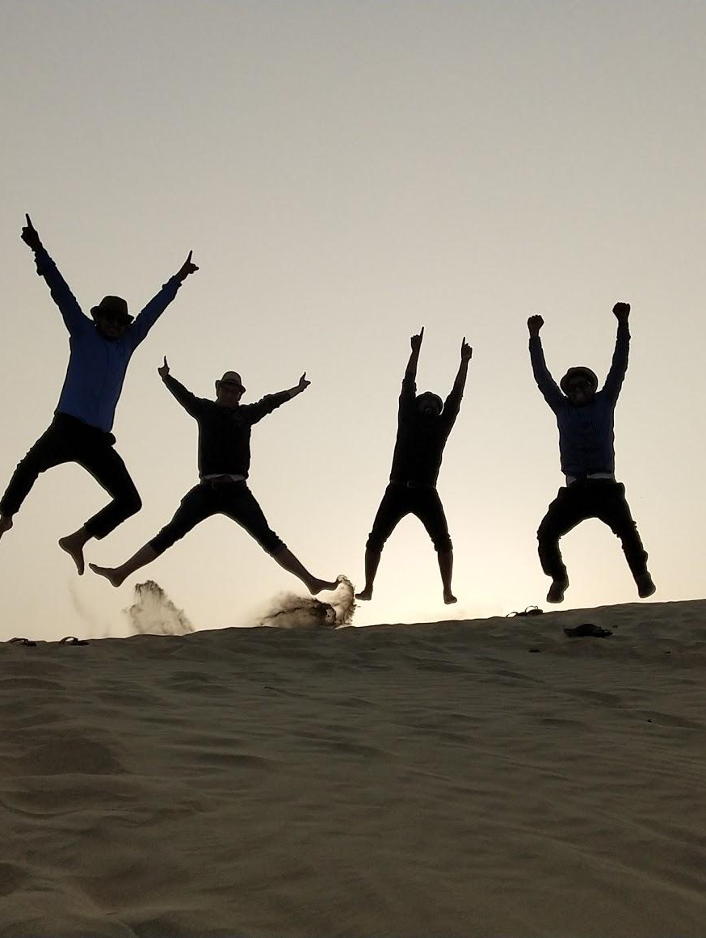
Conclusion
This paper provides one approach under the stimulated condition for autonomous driving.
The approaches utilize deep learning methods and end to end learning to achieve emulation of vehicles
Thus, this method is suitable for training and implementing an autonomous car for a set environment, that does not change unpredictably.

Slide 18
References
Nicolas Gallardo, “Autonomous Decision Making for a Driver-less Car”, 2017.
S. Liu et al., Creating Autonomous Vehicle Systems, Morgan Claypool Publishers, 201
D. Bemstcin, and A. Kamhauser, (2012) “An Introduction to MapMatching far Personal Navigation Assistants”, Princeton University, Princeton, New Jersey, August 2012
U-Blox 7 GNSS Modules Datasheet, document UBX-13003830, R07, U-blox, Thalwil, Switzerland, Nov. 2014.
A. Joshi and M. R. James, “Generation of accurate lane-level maps from coarse prior maps and lidar,” IEEE Intell. Transp. Syst. Mag., vol. 7, no. 1, pp. 19–29, Spring 2015.
Qudsia Memon , Shahzeb Ali, Wajiha Shah, “Self-Driving and Driver Relaxing Vehicle”, 2016.
Naveen S Yeshodara, 2Nikhitha Kishore, “Cloud Based Self Driving Cars”, 2014
https://medium.com/swlh/behavioural-cloning-end-to-end-learning-for-self-driving-cars-50b959708e59

Slide 19
Thank you.

